Slide 1
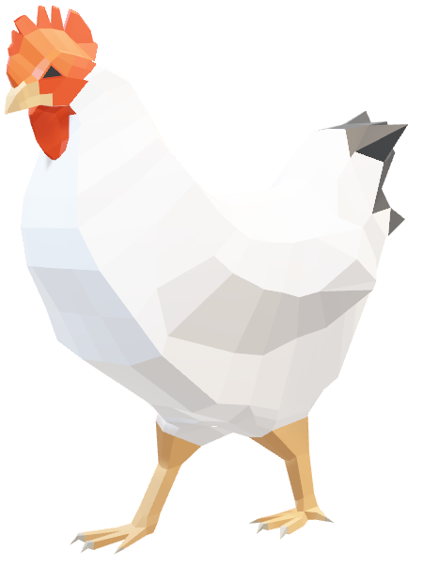
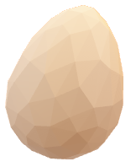
EGG DROP LAB
1
Notes:
Title slide, do whatever

Slide 2
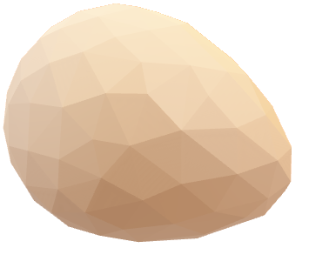
Tasked with designing, building, and testing a structure that will allow a raw egg to fall on a hard surface without cracking or breaking, we decided to attempt to maximize the impact time and divert the force to minimize the instantaneous force applied to the egg while still maintaining the same impulse.
GOAL
2
Notes:
So, you all know the problem: save an egg from a fall without the surface cracking or breaking.
To do this, we decided to maximize the impact time and try to direct the impact force away from the egg itself.

Slide 3
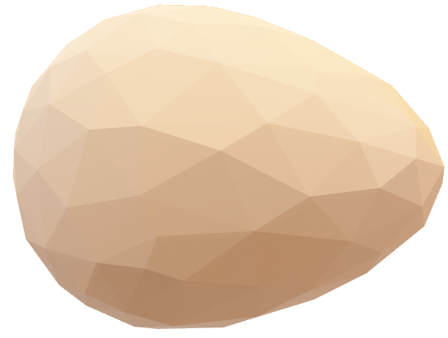
As the structure increases in mass, the velocity at impact remains the same, but the momentum will increase; the mass of the whole system must be accounted for.
Nothing can be attached directly to the egg through glue
The structure cannot be tested prior to the drop
CHALLENGES
3
Notes:
We faced a few challenges.
First, every piece that you add to your structure trades off mass for cushioning, this added momentum has to be dealt with somehow.
Second, none of the materials were allowed to be glued to the egg, rubber banding to the egg was allowed but the force of the tension complicated things.
And the biggest challenge, we couldn’t test our structure before the drop day.

Slide 4
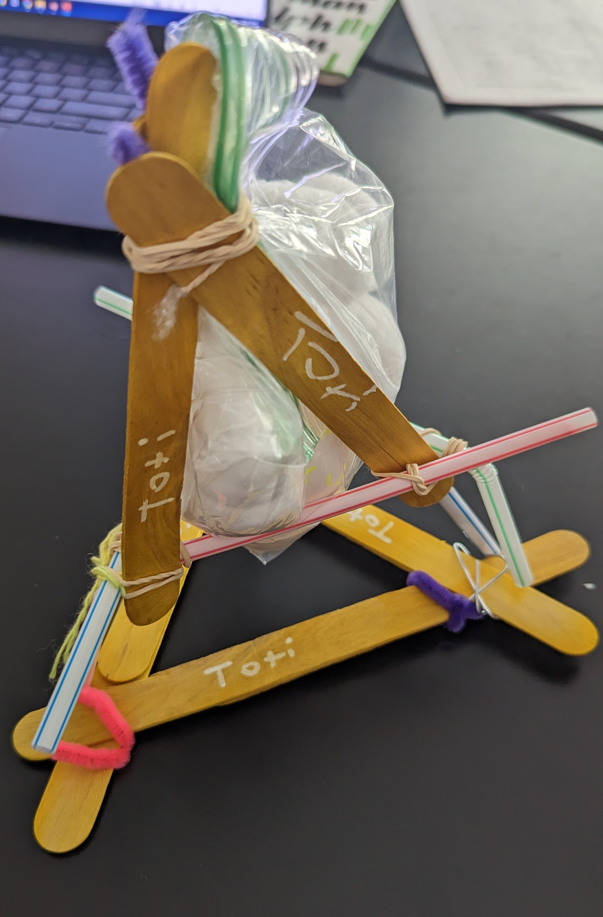
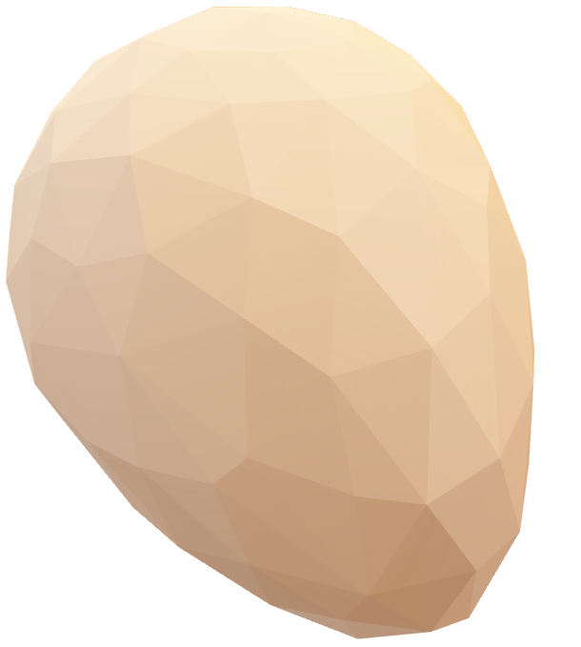
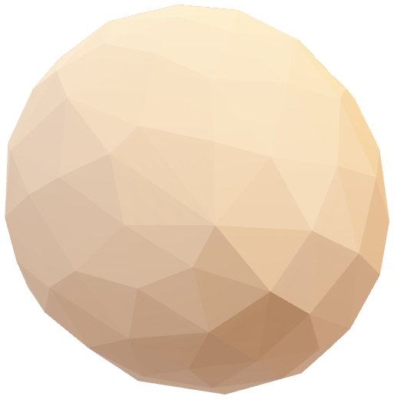
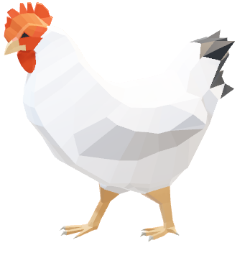
DESIGN
4

Slide 5
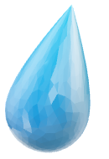
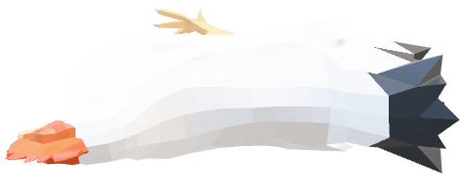

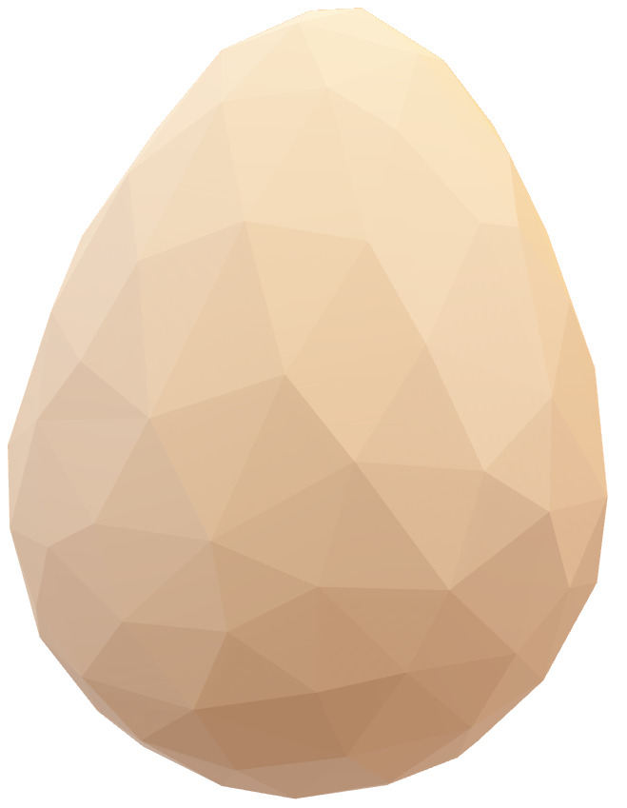
Results information
RESULTS
5

Slide 6
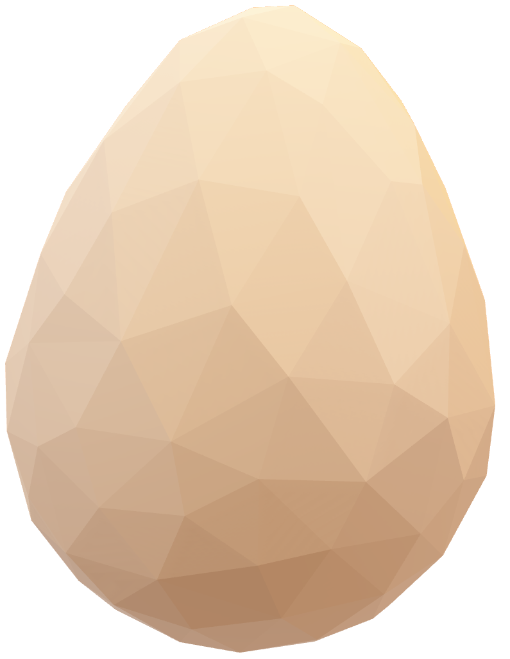
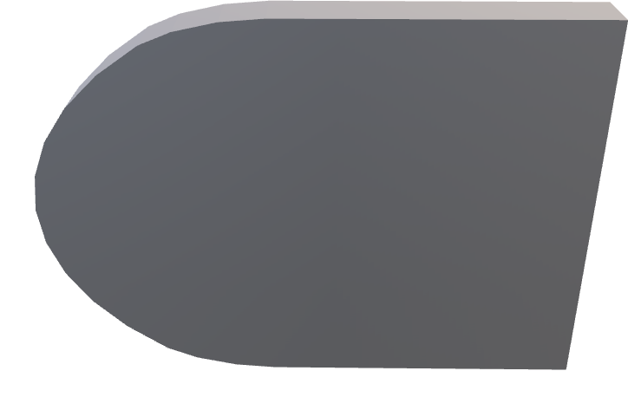
Improvements information
IMPROVEMENTS
6

Slide 7
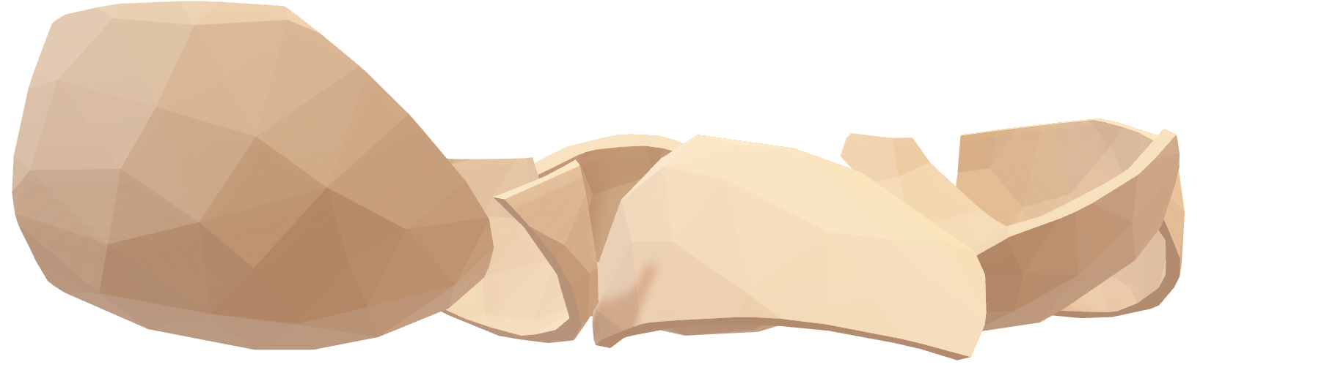
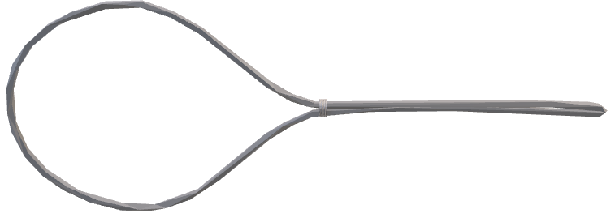
END

